Slide 1

Vel Tech Rangarajan Dr. Sagunthala R&D Institute of Science and Technology
School of Computing
Department of Computer Science and Engineering
10211CS224 / FULL STACK APPLICATION DEVELOPMENT (JAVA)
PROJECT REVIEW : MILESTONE PROJECT – 1
Date: 23-03-2026
End-to-End Event Lifecycle & Ticketing Platform
SDG: 9 - Industry, Innovation and Infrastructure
Presented By:
S.Sarika– VTU26196 – Reg.No. 23UECS0499
Courses Handling Faculty:
Mr. S Manohar ME., (Phd)

Slide 2
INTRODUCTION
1
Event management and ticket booking are often handled manually, leading to inefficiency and errors. Many organizers lack a centralized system to manage events and track seat availability. This project is important because it automates the complete event lifecycle in a structured manner. It minimizes human errors in ticket counting and improves transparency. The system ensures real-time seat updates and prevents overbooking issues. It allows organizers to create, publish, and manage events easily. Users can view events, check seat availability, and book tickets dynamically. Overall, the platform provides an efficient and scalable event lifecycle and ticketing solution.
2
3
4
5
6
7
8
9

Slide 3
PROBLEM STATEMENT
In many organizations, event management and ticket booking are handled manually or through unstructured systems. This leads to errors in seat tracking and booking management. Organizers often face difficulties in updating event status and monitoring availability. Manual processes increase the risk of overbooking and data inconsistency. There is no proper lifecycle-based control to manage events from creation to completion. Users may not receive accurate, real-time information about seat availability.
Therefore, a reliable event lifecycle and ticketing platform is needed to improve efficiency and accuracy.
1
2
3
4
5
6
7
8
9

Slide 4
OBJECTIVE(S)
1
To design and develop a centralized event lifecycle and ticketing management system that automates event creation, publishing, booking, and status tracking
To implement real-time seat availability tracking and secure booking validation to ensure accurate ticket management.
2
3
4
5
6
7
8
9

Slide 5
PROPOSED SYSTEM
The proposed system is a centralized event lifecycle and ticketing management platform. It automates event creation, publishing, booking, and status updates. The system provides real-time seat tracking to prevent overbooking issues. It eliminates manual errors in ticket counting and data handling. Organizers can efficiently manage events through structured lifecycle stages.
1
2
3
4
5
6
7
8
9

Slide 6
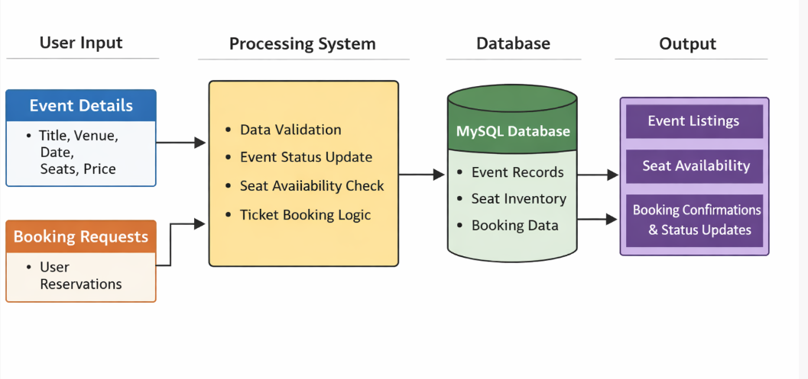
PROPOSED SYSTEM ARCHITECTURE
1
2
3
4
5
6
7
8
9

Slide 7
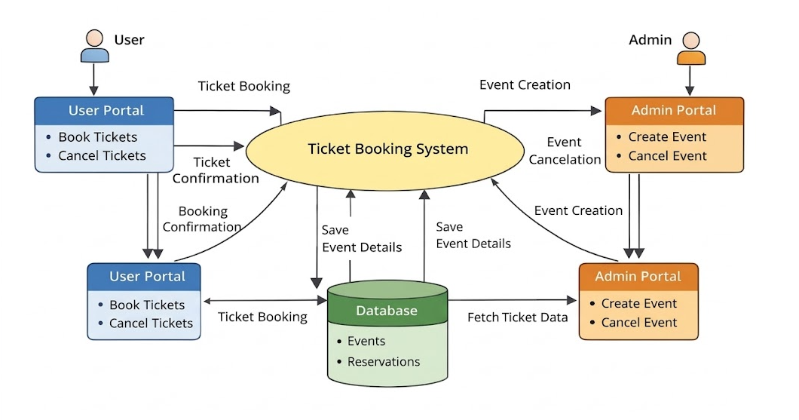
WORKFLOW
1
2
3
4
5
6
7
8
9

Slide 8
TECHNOLOGIES USED
1
Frontend: HTML, CSS, Thymeleaf (User Portal and Admin Portal Interface)
Backend: Spring Boot ,Java, REST Controllers, Service Layer
Database: MySQL (Stores Events and Booking Details)
Tools: Eclipse IDE , MySQL Workbench, Maven
Hardware/Software Requirements: Minimum 8GB RAM, Intel i3 or above, Windows 10/11, JDK 17+, MySQL Server, Web Browser (Chrome/Edge)
2
3
4
5
6
7
8
9

Slide 9
MODULE DESCRIPTION
Module 1: Admin Portal Management Handles event creation, event cancellation, and event status management by the administrator.
Module 2: User Portal Management Allows users to view events, book tickets, cancel tickets, and receive booking confirmation.
Module 3: Ticket Booking Processing Implements seat availability validation, booking logic, ticket cancellation logic, and status updates.
Module 4: Database Management Manages storage and retrieval of event details, booking records, seat counts, and ensures data integrity
1
2
3
4
5
6
7
8
9

Slide 10
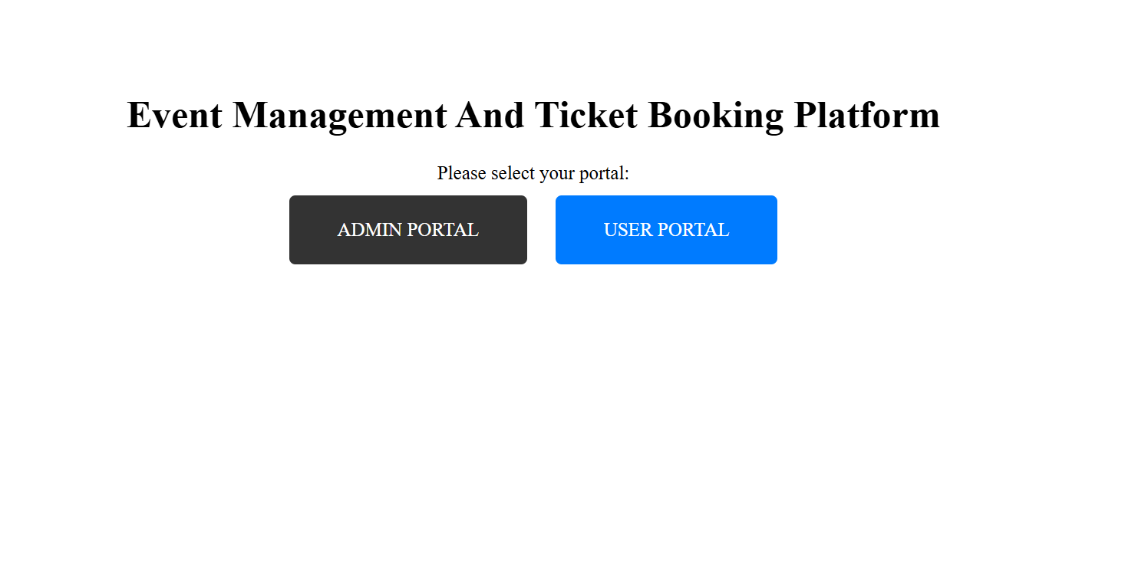
IMPLEMENTATION SCREENSHOTS
Home
1
2
3
4
5
6
7
8
This is the main landing page of the system where users can choose between the Admin Portal and User Portal. It provides role-based access to manage events or book tickets securely.
9

Slide 11
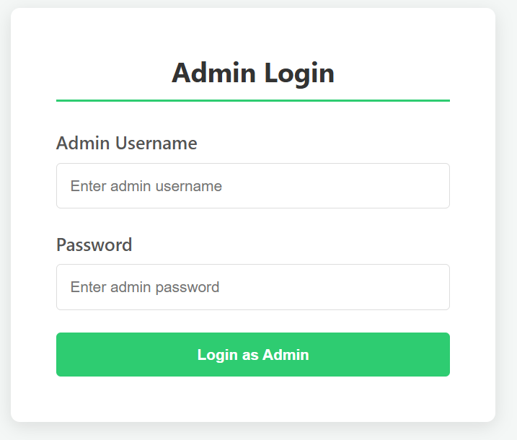
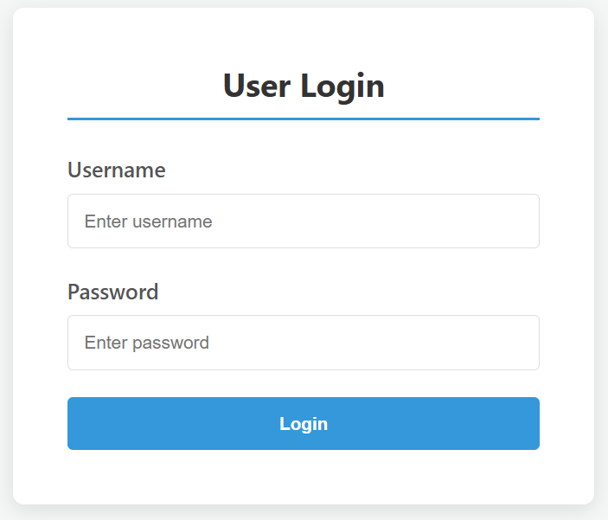
IMPLEMENTATION SCREENSHOTS
Admit login
1
2
3
4
5
6
7
8(A)
9
This page allows the administrator to securely log in using a username and password. It ensures authorized access to event creation, cancellation, and management features.
This page allows registered users to log in securely using their username and password. After successful authentication, users can view events, book tickets, and manage their bookings.

Slide 12
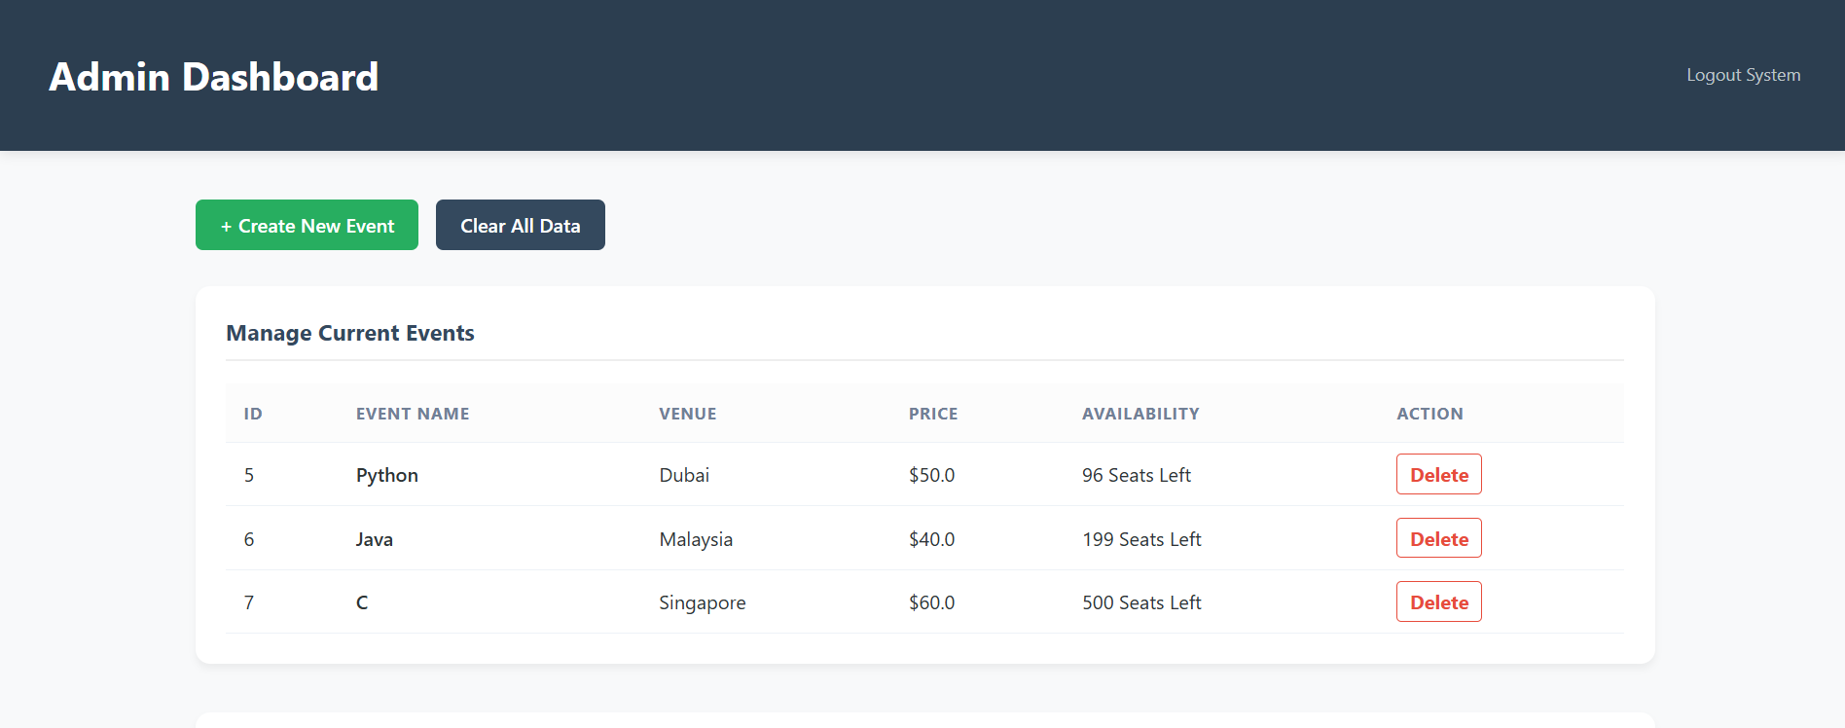
IMPLEMENTATION SCREENSHOTS
1
2
3
4
5
6
7
8(B)
9
This dashboard allows the admin to create new events, delete events, and manage current event details. It also displays all system bookings with ticket status and total price for monitoring and control.

Slide 13
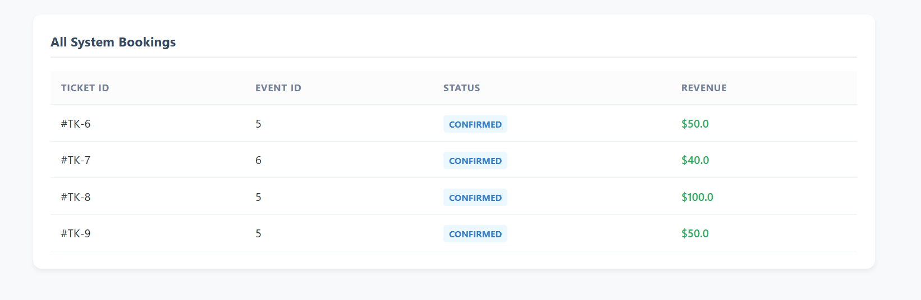
IMPLEMENTATION SCREENSHOTS
1
2
3
4
5
6
7
8(B)
9
This dashboard allows the admin to create new events, delete events, and manage current event details. It also displays all system bookings with ticket status and total price for monitoring and control

Slide 14
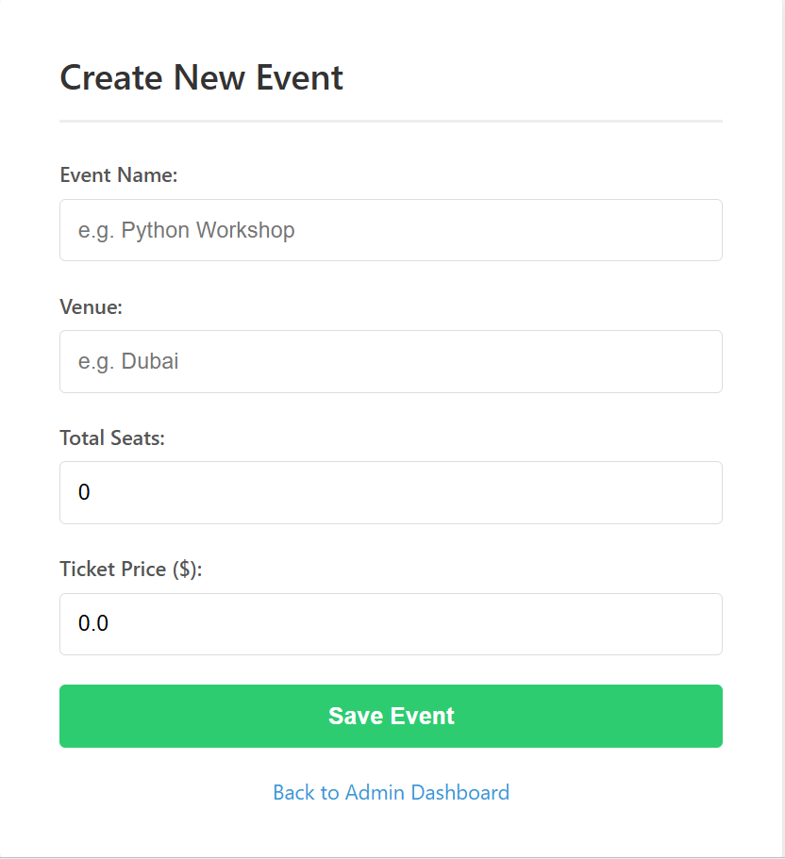
IMPLEMENTATION SCREENSHOTS
1
2
3
4
5
6
7
8(C)
9
This page allows the admin to add new events by entering event name, venue, total seats, and ticket price. After submitting, the event is saved to the system and becomes available for booking.

Slide 15
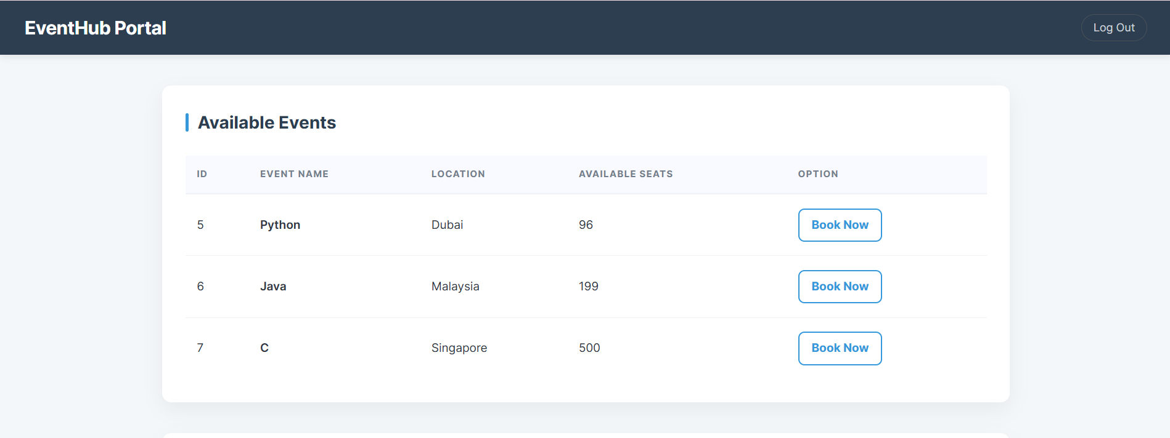
IMPLEMENTATION SCREENSHOTS
1
2
3
4
5
6
7
8(C)
9
This page provides a user portal where guests can view a list of "Available Events" with details like venue and seat count. Users can book new tickets or manage their current reservations in the "My Bookings" section, which includes an option to cancel specific quantities.

Slide 16
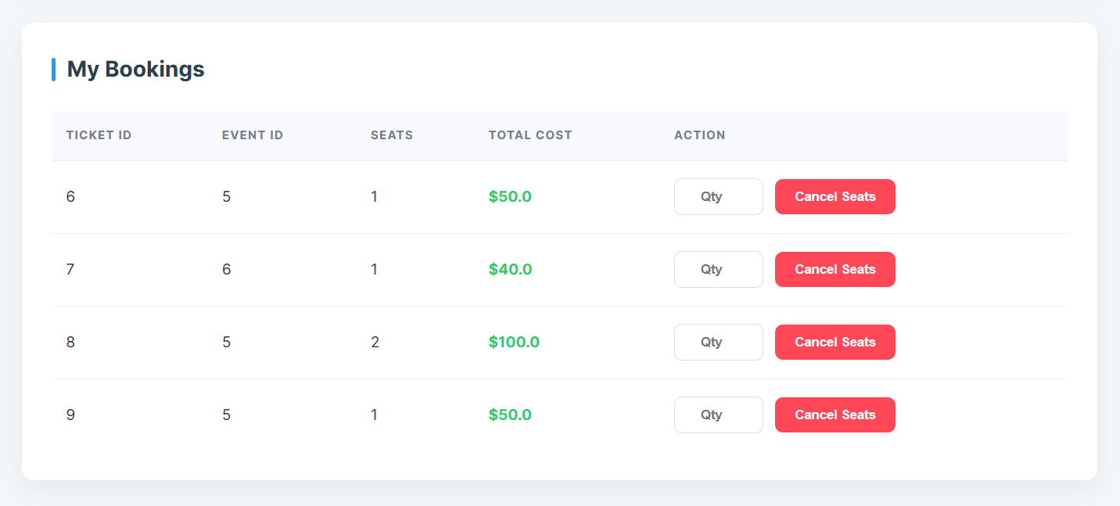
IMPLEMENTATION SCREENSHOTS
1
2
3
4
5
6
7
8(C)
9
This page provides a user portal where guests can view a list of "Available Events" with details like venue and seat count. Users can book new tickets or manage their current reservations in the "My Bookings" section, which includes an option to cancel specific quantities.

Slide 17
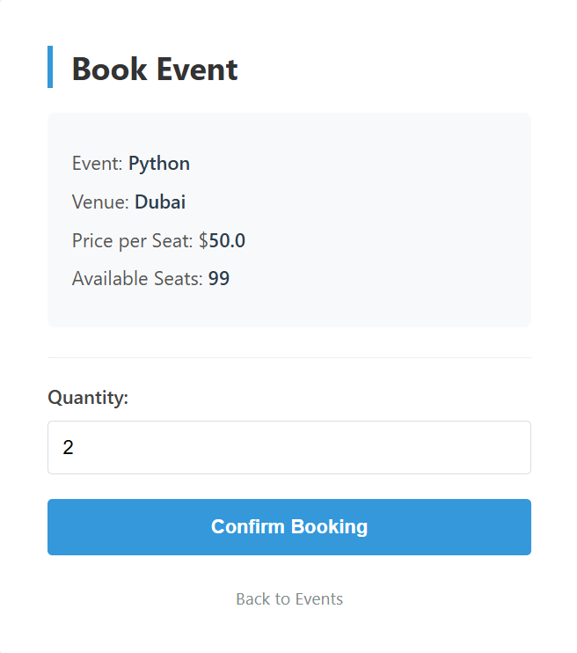
IMPLEMENTATION SCREENSHOTS
1
2
3
4
5
6
7
8(C)
9
This page is a user booking portal that allows individuals to view a list of available events, such as Python, Java, or C workshops, along with their respective venues and seat availability. Users can reserve seats for an event through a structured booking form and manage their personal reservations, including the option to cancel specific ticket quantities.

Slide 18
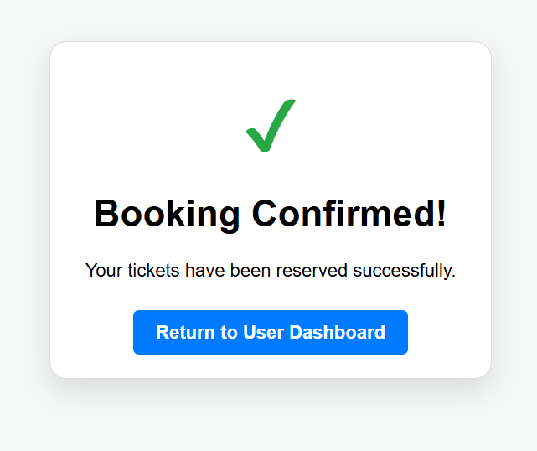
IMPLEMENTATION SCREENSHOTS
1
2
3
4
5
6
7
8(C)
9
This page is a booking confirmation screen that provides immediate feedback to the user after a successful transaction. It features a prominent "Booking Confirmed!" message with a green checkmark and a "Return to User Dashboard" button to help the user navigate back to their main event list.

Slide 19
ADVANTAGES & LIMITATIONS
1
Advantages
Easy event creation and management for admins.
Secure login system ensures authorized access.
Real-time seat availability tracking.
Limitations
Requires internet connection to access the system.
No mobile application support
2
3
4
5
6
7
8
9

Slide 20
Thank you

